Slide 1
The Future

Slide 2
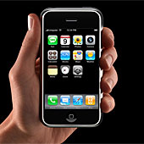
2007
In 2007: Only 3 years ago:
-Apple releases the iPhone
-Umbrella by Rihanna was the top hit
-The Mortgage Crisis begins in the U.S.

Slide 3
2001
In 2001: Only 9 years ago:
- The Xbox & Game cube were released.
- 7 million websites existed.
- 11 million people ages 10-24 had cell phones.
Now, over 50 million do.
- Britney Spears was incredibly popular and WASN’T crazy!!
- MySpace didn’t exist.
- The U.S. suffered the worst terrorist attack
in history on 9/11.

Slide 4
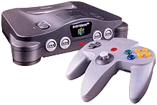
1997
In 1997: Only 13 years ago:
- 100,000 websites existed.
- “Macarena” was the number 1 song.
- Gas cost $1.29 a gallon.
- Tickle-me-Elmo was the hottest toy.
- Nintendo 64 was launched.
- The first animal was cloned.
- Miss Place started 7th grade!!

Slide 5
1992
In 1992: Only 18 years ago:
-Nirvana, Pearl Jam and Soundgarden led alternative rock into the mainstream.
-#1 movie: Aladdin, #8 movie: Wayne’s World
-The World Wide Web begins.
-Bill Clinton elected president.
-Miley Cyrus’ dad released Achy Breaky Heart.
-Mortal Kombat came out in arcades.
-Super Nintendo released worldwide.

Slide 6
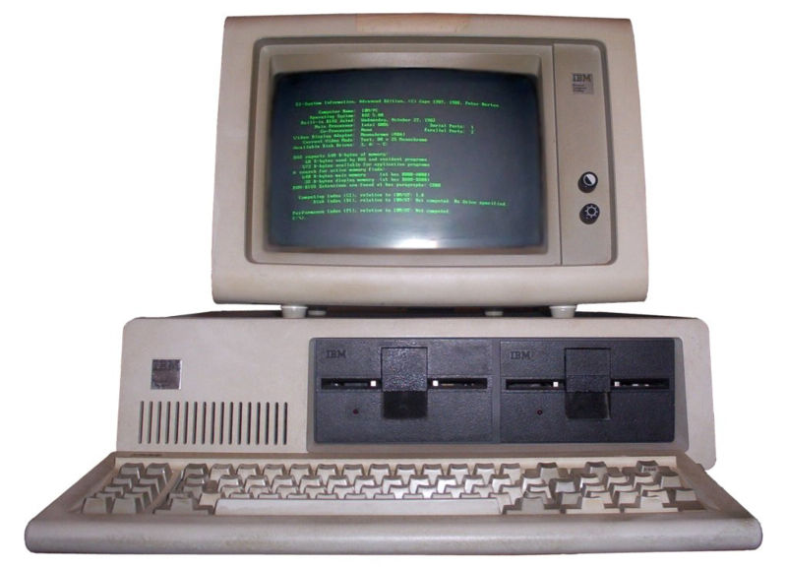
1981
In 1981: Only 29 years ago:
- MTV was born.
- The first home “PC” was released
- Cell phones are TESTED in the US. But they
are not used until 1983.
-”Betty Davis Eyes” is the #1 hit
-Miss Place was not even
BORN yet!!

Slide 7
1980
In 1980: Only 30 years ago:
- Some guy named Bill Gates started a company… in a garage.
-The first cell phone is released in Japan. They wouldn’t be in the US for 3 more years.
-The 2nd Star Wars movie (Empire Strikes Back) was released.
-Ronald Reagan began his presidency.

Slide 8
So, think of your future.

Slide 9
What will cars look like?
How will people communicate?
What great things does my future hold?
Where will I live?
What job will I have?
How big will my house be?
Will I be married? Have kids?

Slide 10
Your assignment
Show me your future!
Think about what the future will hold for you…Job? Technology? Family? Type of entertainment? Location? And answer the following:
1. Write down at least 7 characteristics you foresee in your FUTURE (in terms of job, family, and technology)
2. Pick at least 3 characteristics and explain HOW you will work in the present to achieve these future goals, life styles, and characteristics!
REMEMBER TO USE YOUR IMAGINATION TO PREDICT THE FUTURE!!

